Slide 1
DBMS COURSE PROJECT
Student Attendance &
Leave Approval System
A MySQL relational database for daily attendance tracking, attendance percentage reporting and faculty-approved student leave
5
5
MySQL
Tables
Relationships
Platform
M. Pranay Kumar Reddy · Roll No. 25WU0102138 · Section: AI&ML Panthers
Notes:
Introduce the project: a MySQL database that replaces manual attendance registers and paper leave slips with five related tables.

Slide 2
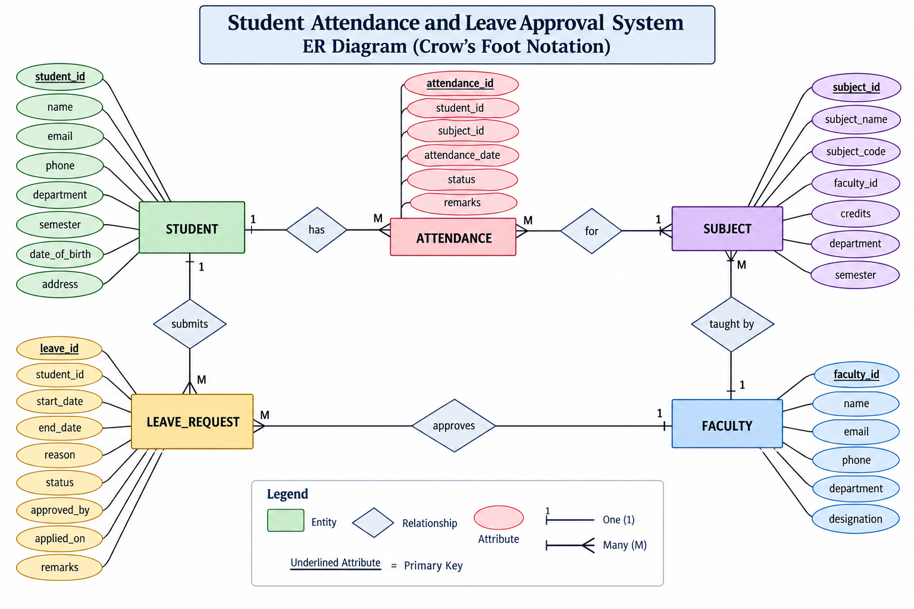

Slide 3
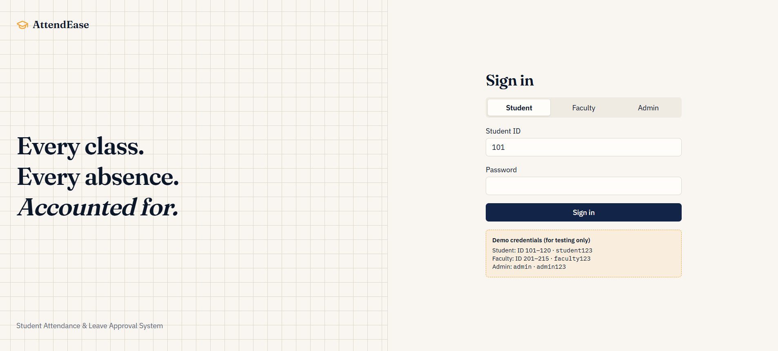

Slide 4
SECTION 1
Project Overview
The system replaces manual attendance registers and paper leave slips with one centralised database. It delivers two major functions.
1
Attendance Management
2
Leave Management
Store daily student attendance
Store student leave requests
Record attendance subject-wise
Track pending, approved and rejected requests
Identify present and absent students
Record which faculty processed the request
Calculate attendance percentages
View complete leave history per student
Find students below the required percentage
Student Attendance & Leave Approval System
2
Notes:
Two functional halves: attendance capture and reporting, and the leave request/approval workflow.

Slide 5
SECTION 2
Objectives
1
Maintain student records
2
Maintain faculty records
3
Store subjects and assigned faculty
4
Record daily attendance
5
Calculate attendance percentages
6
Manage student leave requests
7
Allow faculty to approve or reject leave
8
Reduce manual record keeping
9
Provide simple SQL queries for reporting
Student Attendance & Leave Approval System
3
Notes:
Nine objectives, grouped by colour: master data (plum), attendance (teal), leave and reporting (gold).

Slide 6
SECTION 4
Technology Used
1
2
3
MySQL
SQL
MySQL Workbench
Relational database engine that stores every table and enforces the keys.
Language used for all table creation, inserts, joins and reports.
Visual tool used to run the script, inspect tables and view results.
Database name
student_attendance
No external framework is required for the database version of this project.
Student Attendance & Leave Approval System
5

Slide 7
SECTION 5
The Five Database Tables
student
faculty
subject
Personal and academic details of every enrolled student.
Details of every faculty member who teaches or approves leave.
Subjects offered, each linked to the faculty who teaches it.
PK student_id
PK faculty_id
PK subject_id
FK faculty_id
attendance
leave_request
One row per student, per subject, per class date.
Leave applications with their approval status.
PK attendance_id
FK student_id, subject_id
PK leave_id
FK student_id, approved_by
Student Attendance & Leave Approval System
6

Slide 8
TABLE STRUCTURE · 1 OF 3
student & faculty
student
faculty
student_id
Unique student ID
faculty_id
Unique faculty ID
name
Student name
name
Faculty name
email
Student email
email
Faculty email
phone
Student phone number
department
Faculty department
department
Student department
PRIMARY KEY faculty_id
semester
Current semester
PRIMARY KEY student_id
Both tables are pure master data — they hold no foreign keys, so they are created and populated first.
Student Attendance & Leave Approval System
7

Slide 9
TABLE STRUCTURE · 2 OF 3
subject & attendance
subject
attendance
subject_id
Unique subject ID
attendance_id
Unique attendance record
subject_name
Name of subject
student_id
Student being recorded
faculty_id
Faculty teaching the subject
subject_id
Subject of the class
PRIMARY KEY subject_id
FOREIGN KEY faculty_id -> faculty.faculty_id
attendance_date
Date of class
status
Present or Absent
PRIMARY KEY attendance_id
FOREIGN KEYS student_id, subject_id
Business rule:
a UNIQUE (student_id, subject_id, attendance_date) constraint blocks duplicate attendance for the same student in the same subject on the same day.
Student Attendance & Leave Approval System
8

Slide 10
TABLE STRUCTURE · 3 OF 3
leave_request
leave_request
Two foreign keys, two parents
leave_id
Unique leave request ID
student_id -> student.student_id
approved_by -> faculty.faculty_id
student_id
Student requesting leave
start_date
Leave starting date
This single table records both who asked for leave and who decided on it.
end_date
Leave ending date
reason
Reason for leave
status
Pending, Approved or Rejected
Why approved_by allows NULL
approved_by
Faculty who processed it
A request that is still Pending has not been seen by any faculty member yet, so there is no approver to record. The column stays NULL until a decision is made.
PRIMARY KEY leave_id
FOREIGN KEYS student_id, approved_by
Student Attendance & Leave Approval System
9

Slide 11
SECTION 6
Relationships
Student
Attendance
One student can have many attendance records.
1 : M
Subject
Attendance
One subject can have many attendance records.
1 : M
Faculty
Subject
One faculty member can teach multiple subjects.
1 : M
Student
Leave_Request
One student can submit multiple leave requests.
1 : M
Faculty
Leave_Request
A faculty member can process many leave requests.
1 : M
The approved_by column identifies which faculty member processed each request.
Student Attendance & Leave Approval System
10

Slide 12
SECTIONS 7 & 8
Status Values
Leave request status
Attendance status
Pending
Present
Submitted but not yet processed by any faculty member.
The student attended that subject's class on that date.
Approved
Absent
The faculty member has accepted the leave request.
The student did not attend that class.
Rejected
Both are stored as ENUM columns, so MySQL itself rejects any value outside this fixed list.
The faculty member has rejected the leave request.
Student Attendance & Leave Approval System
11

Slide 13
SECTION 10
Installation & Setup
1
2
3
4
Install MySQL
Open Workbench
Open the script
Execute all
Install MySQL Server together with MySQL Workbench.
Connect to your local server and open a new SQL tab.
File > Open SQL Script and choose student_attendance_leave.sql.
Press the lightning-bolt button, or Ctrl + Shift + Enter.
The script then runs automatically, in order:
Creates the database
Selects the database
Creates all five tables
Adds primary keys
Adds foreign keys
Inserts faculty, students & subjects
Inserts 160 attendance records
Inserts 10 leave requests
Student Attendance & Leave Approval System
12
Notes:
The script drops and recreates the database each run, so it is always safe to re-execute.

Slide 14
SECTION 11
Basic Queries
Simple SELECT statements to confirm every table loaded correctly.
-- View all master data
SELECT * FROM student;
SELECT * FROM faculty;
SELECT * FROM subject;
-- View the transaction tables
SELECT * FROM attendance;
SELECT * FROM leave_request;
What you should see
8 students · 4 faculty · 5 subjects · 160 attendance rows · 10 leave requests
Why 160 attendance rows?
8 students × 5 subjects × 4 class dates = 160.
Enough data for the percentage and shortage reports to return meaningful results.
Student Attendance & Leave Approval System
13

Slide 15
SECTION 12
Attendance Reports
-- Attendance percentage for every student
SELECT s.name,
COUNT(*) AS total_classes,
SUM(a.status = 'Present') AS attended,
ROUND(SUM(a.status = 'Present')*100.0
/ COUNT(*), 2) AS percentage
FROM student s
JOIN attendance a ON s.student_id = a.student_id
GROUP BY s.student_id, s.name;
Sample output
Aarav Sharma
95%
Karthik Reddy
90%
Diya Patel
85%
Meera Joshi
80%
Sneha Nair
75%
-- Shortage list: below the 75% requirement
SELECT s.name,
ROUND(SUM(a.status='Present')*100.0
/ COUNT(*), 2) AS percentage
FROM student s
JOIN attendance a ON s.student_id = a.student_id
GROUP BY s.student_id, s.name
HAVING percentage < 75;
Rohan Verma
70%
Ananya Iyer
60%
Vikram Singh
55%
Three students fall below 75% and appear on the shortage list.
Student Attendance & Leave Approval System
14

Slide 16
SECTION 13
Leave Management Queries
-- Requests still waiting for a decision
SELECT l.leave_id, s.name,
l.start_date, l.end_date, l.reason
FROM leave_request l
JOIN student s ON l.student_id = s.student_id
WHERE l.status = 'Pending';
-- Approve a request
UPDATE leave_request
SET status = 'Approved',
approved_by = 101
WHERE leave_id = 2;
-- Reject a request
UPDATE leave_request
SET status = 'Rejected',
approved_by = 102
WHERE leave_id = 6;
-- Full leave history with approver
SELECT s.name, l.start_date, l.end_date,
l.reason, l.status, f.name
FROM leave_request l
JOIN student s ON l.student_id=s.student_id
LEFT JOIN faculty f
ON l.approved_by = f.faculty_id;
Student Attendance & Leave Approval System
15
Notes:
LEFT JOIN is used for history because a pending request has no approver yet — an INNER JOIN would silently hide those rows.

Slide 17
SECTION 14
Example Workflow
Recording attendance
Approving leave
1
Faculty opens the class session
1
Student submits a leave request
2
Faculty marks each student
2
Request status is set to Pending
3
Attendance record is created
3
Faculty reviews the request
4
Row stored in the attendance table
4
Faculty approves or rejects it
5
Percentage report is generated
5
Status and approved_by are updated
Student Attendance & Leave Approval System
16

Slide 18
SECTION 15
Sample Use Case
Aarav Sharma applies for two days of medical leave.
Pending
Approved
Student
Aarav Sharma
Student
Aarav Sharma
Start date
2026-09-10
→
Start date
2026-09-10
End date
2026-09-11
End date
2026-09-11
Reason
Medical reason
Reason
Medical reason
Approved by
NULL
Approved by
Dr. Amit Sharma
UPDATE leave_request SET status = 'Approved', approved_by = 101 WHERE leave_id = 1;
Student Attendance & Leave Approval System
17

Slide 19
SECTION 16
Advantages
1
2
3
Simple design
Less manual work
Centralised leave
A clean five-table relational model that is easy to explain and defend.
Replaces paper registers and handwritten leave slips.
Every request and decision lives in one table.
4
5
6
Instant reporting
Data consistency
Extensible
Attendance percentages are calculated by a single query.
Primary and foreign keys prevent orphaned records.
Can grow into a full web or mobile application.
Student Attendance & Leave Approval System
18

Slide 20
SECTION 17
Future Enhancements
1
Security & access
2
Features
3
Reporting & reach
Student, faculty and admin login
Email notifications
Monthly attendance reports
Role-based access control
Leave document uploads
Dashboard and charts
Password authentication
Attendance percentage alerts
Department-wise reports
Audit logs
Multiple faculty approvals
REST API, web & mobile apps
Student Attendance & Leave Approval System
19

Slide 21
SECTION 18
Suggested Application Architecture
The current project delivers the database layer. A full-stack build would add two layers above it, without changing the core schema.
1
Web / Mobile Frontend
Future
The screens students and faculty actually use.
2
REST API Backend
Future
Business rules, validation and authentication. Java Spring Boot is a natural fit.
3
MySQL Database
Built
The five tables, keys, constraints and reporting queries built in this project.
Student Attendance & Leave Approval System
20

Slide 22
SECTION 20
Conclusion
The system provides a simple relational database solution for managing student attendance and leave applications, and can serve as the foundation for a larger college management application.
DBMS concepts demonstrated
Database creation
Table creation
Primary keys
Foreign keys
One-to-many relationships
INSERT operations
SELECT queries
JOIN operations
UPDATE operations
GROUP BY
HAVING
Aggregate functions
Thank you
M. Pranay Kumar Reddy · 25WU0102138
Student Attendance & Leave Approval System
21

